Slide 1
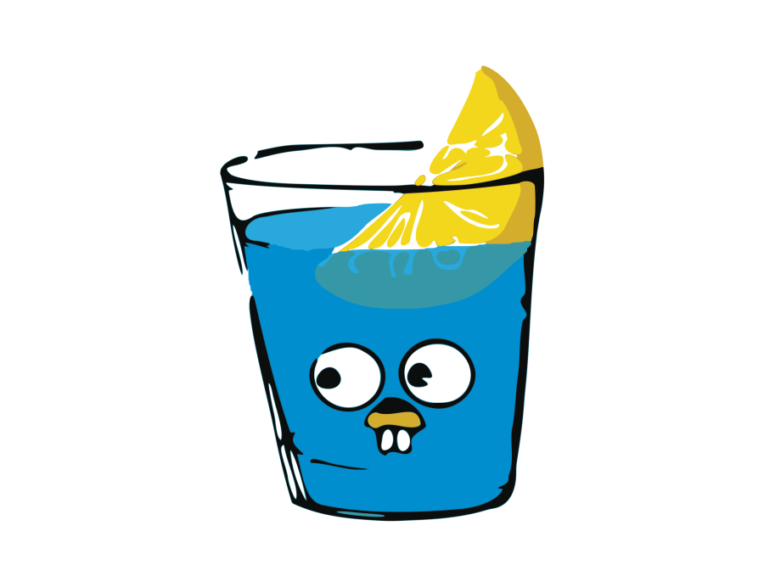
GIN OF GO
Castro Soberanes Luis Alexis
Silva Sanchez Alvaro Daniel
Armas Jimenez David Alonso
Reyes Torres Oscar Manuel

Slide 2
TABLE OF CONTENTS
01
02
03
WHAT IS?
ADVANTAJE
DISADVANTAJE
04
05
06
CHARACTERISTICS
EXAMPLES
ARCHITECTURE

Slide 3
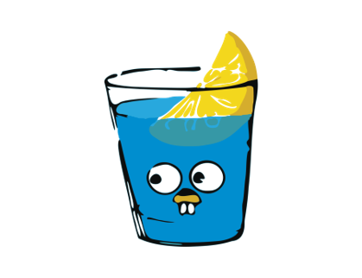
WHAT IS GIN?
GIN IS:
It is a framework web builder for Go that makes it easy to create web applications and APIs. Gin provides a set of tools and utilities that help simplify route creation, middleware management, handling HTTP requests and responses, among other aspects necessary for developing efficient and fast web applications in Go.

Slide 4
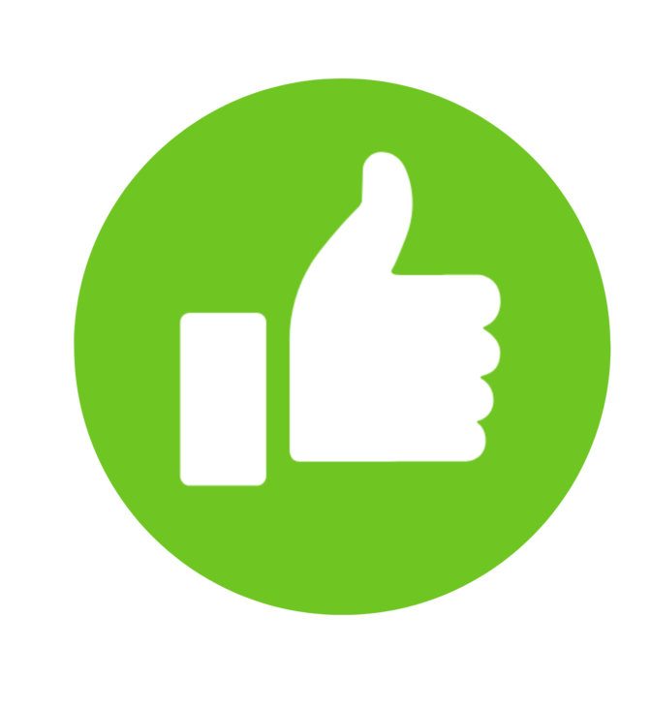
GIN ADVANTAGE
PERFORMANCE: Gin is known for its high performance and low latency, making it suitable for high-traffic web applications and APIs.
SIMPLICITY: Gin has a simple and easy-to-learn syntax, which makes it easy for developers who are just starting with Go.
ROUTING AND MIDDLEWARE: It offers efficient routing and a flexible middleware system, simplifying the management of HTTP requests.
LOOSE COUPLING: You can use only the parts of Gin that you need, avoiding excessive coupling and promoting modularity.
DOCUMENTATION AND COMMUNITY: Gin has good documentation and an active community, making problem-solving and getting help easier.

Slide 5

GIN DISADVANTAGE
Fewer Features than Other Frameworks: Compared to some other web frameworks, Gin may seem lighter in terms of pre-built features.
Go Learning Curve: If you're not familiar with Go, you'll need to learn the language before using Gin.

Slide 6
CHARACTERISTICS
Fast Radix tree based routing, low memory consumption. No reflection. Predictable API performance.
Middleware support An incoming HTTP request can be handled by various chained middleware and final action. Example: Logger, Authorization, GZIP and finally save the message in the DB.
Crash free Gin can receive and recover from a panic that occurred during an HTTP request. This way your server will always be available. It is also possible to make a panic report, for example to Sentry!
JSON Validation Gin allows you to analyze and validate JSON data in a request, and for example, check the existence of required data.
Route grouping Organize your routes better: Authorized routes vs public routes, different API versions. Additionally, route groups can be nested unlimitedly without affecting performance.
Error handling Gin offers a convenient way to collect errors that occur during an HTTP request. A middleware can even record them in a log file, the DB or send them over the network.
Render included Gin has an easy-to-use API for rendering JSON, XML, and HTML.
Extensible Creating new middleware is very simple. You just have to review the example codes.

Slide 7

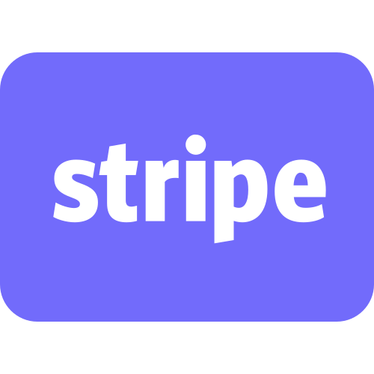

GIN EXAMPLES
GitHub API
Stripe API
Google Cloud
The GitHub REST API is built with Gin. This API provides access to information about repositories, users, commits, etc.
The Stripe REST API is built with Gin. This API provides access to payment services such as payments, refunds, and billing.
The Google Cloud Platform REST API is built with Gin. This API provides access to Google Cloud Platform services such as Compute Engine, Cloud Storage, and Cloud SQL.

Slide 8
ARCHITECTURE
Model: In Gin, models represent the data layer of the application. Models are data structures that define the structure of the information that is stored in the database or used in the application. Gin does not prescribe a specific ORM (Object-Relational Mapping), so you can choose the one that best suits your needs, such as GORM, XORM, etc.
View: Gin does not have a view layer in the traditional sense of an MVC framework. Instead, it focuses on creating RESTful APIs, so it doesn't handle HTML views or templates. If you need to serve HTML views, it is common to use a templating engine such as HTML/template from the Go standard library or a third-party package such as "html/template" or "gorilla/mux".
Controller: In Gin, controllers are functions that handle HTTP requests. Instead of using a specific handler structure, Gin uses function handlers that are registered for specific paths. Each handler function runs in response to a particular HTTP request and performs application logic such as retrieving data from the database, processing the request, and generating a response.

Slide 9
Thanks!

